Slide 1
HIV Pre-Exposure Prophylaxis (PrEP) Dr Devika Dixit Division of Healthcare Management and Occupational Safety and Health Public Health Team August 31, 2022

Slide 2
Objectives
Describe HIV PrEP and different regimes effectiveness.
Review PrEP eligibility.
Compare HIV pre-exposure prophylaxis (PrEP) and to HIV post-exposure prophylaxis (PEP).
Discuss PrEP in the context of other sexually transmitted infections (STIs).
Outline how to start/stop PrEP.
UN provisions for PrEP.

Slide 3
Terminology
Cisgender – denoting a person whose personal identity/gender corresponds with their birth sex
Transgender – gender/personal identity differs from sex assigned at birth
MSM – men who have sex with men
NRTI – nucleoside reverse transcriptase inhibitor
INSTI – integrase inhibitor

Slide 4
What is HIV PrEP ?
Pre-exposure prophylaxis medication (antiretroviral(s)) given to individuals who are HIV negative and are at substantial ongoing risk of exposure/infection to HIV
Goal: To prevent HIV-1 acquisition
Part of a comprehensive set of tools to prevent spread of HIV

Slide 5
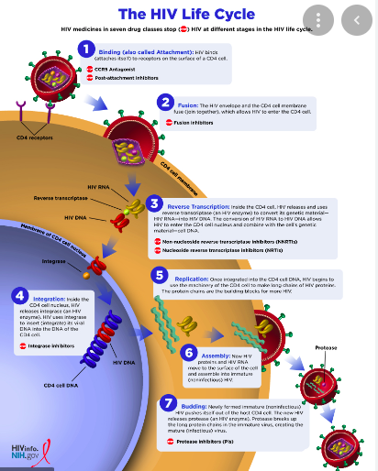
HIV PrEP Drugs Site of Action
Nucleoside reverse
transcriptase
Inhibitors (NRTIs)
Emtricitabine
Tenofovir
(ADDITION: lamivudine (PEP))
Dapivarine
Integrase inhibitors
(INSTI)
Cabotegravir
(Dolutegravir)

Slide 6
HIV PrEP
Medication given either via pills, vaginal ring or injection
Pills (daily) – since 2015 – access increasing globally:
- Truvada (Emtricitabine -tenofovir disoproxil aka FTC-TDF)– at risk via sex/injection drug use
- Descovy (Emtricitabine-tenofovir alafenamide aka FTC-TAF) – risk via sex excluding people at risk through receptive vaginal sex
Data on use for based on 12 RCTs, and systematic review/meta-analysis ranges 80-85%, as high as >90%, other studies show lower efficacy
Vaginal ring - 2021:
- WHO recommended monthly Dapivirine vaginal ring (DVR) for cisgender women at
substantial risk of HIV (no country has yet included this in their national programme)
- Ring study and ASPIRE (Phase III) found 30% reduction in risk of HIV infection, DREAM
and HOPE had increased ring use with >50% risk reduction

Slide 7
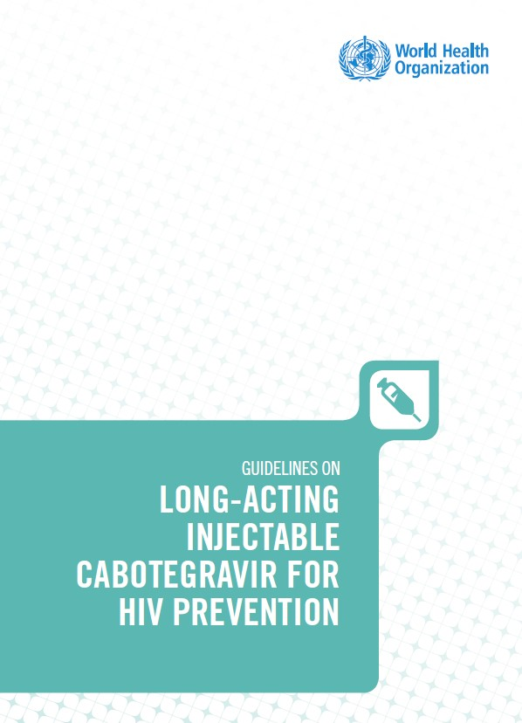
HIV PrEP
Injections (q2 months) – approved by WHO in July 2022:
- Cabotegravir (Apretude) – at risk via sex.
- Can switch in between pill/injection.
- Minimum weight 35 kg.

Slide 8
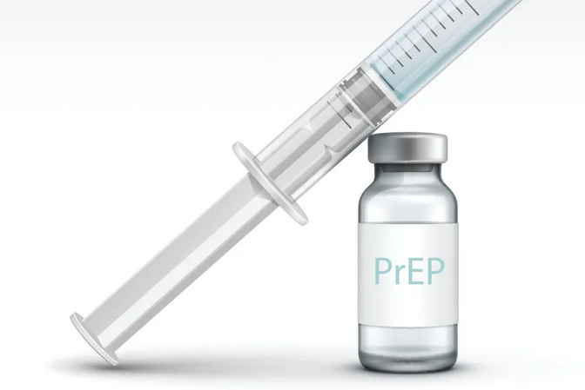
Cabotegravir
Long-acting integrase inhibitor.
Given by Intramuscular injection .
First two injections are 4 weeks apart followed by 8 weeks apart.
Studies found this resulted in a 79% relative risk reduction in HIV compared with oral PrEP.
Adherence is a big factor.
Implementation/ensuring availability and access to this medication is in progress.

Slide 9
Cabotegravir
Safety, efficacy and effectiveness studies including >8000 patients;
Four studies (all multisite RCT):
- Two phase IIb/III studies [HPTN 083 and HPTN 084] assessed efficacy of cabotegravir vs daily
TDF/FTC (79% [66-88%] reduction in risk of cabotegravir vs TDF/FTC)
- Two IIa studies [ÉCLAIR and HPTN 077] were on safety and dosing of
cabotegravir.
Summary: Cabotegravir is superior
to oral TDF-FTC in MSM/transgender
women.

Slide 10
HIV “On demand PrEP”
Off label, some health authorities have recommendations for this type of use, WHO recommended in 2019.
On demand PrEP guidance is available and data for MSM only (not people who inject drugs, or heterosexual men/women).
“2-1-1” schedule: 2 pills 2-24 hours before sex, 1 pill 24 hours after 1st dose and 1 pill 24 hours after second dose

Slide 11
PrEP Effectiveness (1)
Overall PrEP reduces HIV transmission via sex by >90%
Less data for people who inject drugs – PrEP pills reduce the risk of getting HIV by 79% (shot not recommended for this group)
PrEP needs to be taken to be effective! Missed doses, less effective.

Slide 12
PrEP Effectiveness (2)
PrEP pills take about 7 days to reach maximum protection for receptive anal sex.
For receptive vaginal and injection drug use PrEP pills take about 21 days to reach maximum effectiveness
No data for insertive vaginal or anal sex
No data on how long it takes for PrEP shots to reach max protection during sex

Slide 13
PrEP Eligibility
In those who are HIV negative and at substantial risk of HIV acquisition:
Male / Female
From sexual transmission
- Partner has HIV (particularly if HIV viral load is unknown or detectable)
- Inconsistent condom use
- Diagnosis with sexually transmitted infection in the last 6 months
Those who inject drugs/ share drug paraphernalia and/or has a partner who does
Those who have received PEP
- Multiple courses
- Reported continued risk behavior

Slide 14
Who is PrEP not for?
Not for potential exposures to blood and bodily fluids due to occupational risk (e.g., healthcare workers, UN personnel).
Not for those who are already HIV positive.
Not for anyone who had an exposure to HIV within the last 72 hours.
Severe allergies to drug/drug products.
Caution for liver/kidney abnormalities

Slide 15
Initiation/Discontinuation of PrEP
Initiation done in consultation with your physician-voluntary
Ensure HIV negative prior to initiation (history review), renal function should be done prior to starting oral regimes and checked q6-12 months.
Liver function for INSTI
Screen for coinfections
Follow- up appointments (q2-3 months)
Adherence important
Missed doses
Increases risk of failure
Condom use
Discontinuation in discussion with physician (risks/benefits)

Slide 16
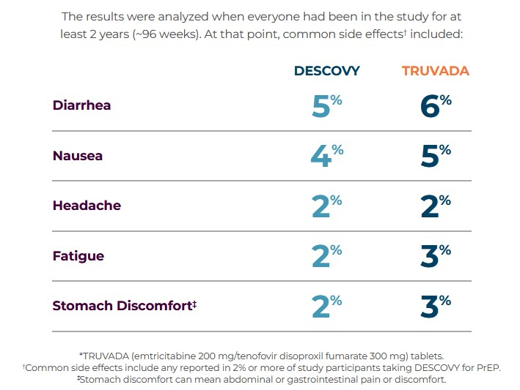
Common Side Effects of PrEP
Well tolerated medications
GI: abdominal pain, diarrhea, nausea
Generalized: Headache, fatigue
Cabotegravir: hepatotoxicity, ?resistance mutations for INSTI
Tenofovir: renal toxicity
Side effects similar in oral/IM regime (except site reactions)
https://www.descovy.com/side-effects

Slide 17
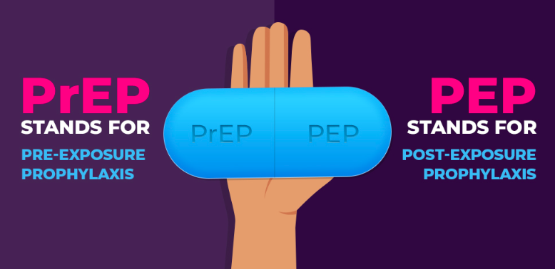
PrEP Vs PEP
Image from: https://prepdaily.org/whats-the-difference-between-prep-and-pep/

Slide 18
HIV PrEP vs PEP
PrEP | PEP
Given daily or q2 months | Taken daily for 28 days
Do not start within 72 hours of an exposure | Start within 72 hours of exposure
Two drugs or one (emtricitabine/tenofovir or cabotegravir) | CORRECTION: UN PEP kits contain three drug (lamivudine/tenofovir/dolutegravir). Other places use emtricitabine/tenofovir/dolutegravir
In those who are HIV negative | In those who are HIV negative
Used for ongoing risk due to sexual exposure or people who inject drugs | Can be given for occupational and non-occupational exposures
ADDITION: Do not use PEP kit contents for HIV PrEP purposes

Slide 19
HIV PrEP and Other STIs
STIs are common and increasing
HIV PrEP does not protect against other STI
Condom use prevents against STIs

Slide 20
UN Provisions of PrEP
UN is currently providing HIV PEP kits to personnel in all duty stations.
HIV PrEP is not supplied directly by the UN to duty stations.
HIV PrEP can be requested by UN personnel who met the criteria after assessment by their physician or health providers.
Some of the staff health insurance providers may cover PrEP and others may not. UN personnel need to check their coverage before requesting for PrEP

Slide 21
Summary (1/2)
Emtricitabine/TDF (Truvada) | Emtricitabine/TAF (Descovy) | Cabotegravir | Dapivirine vaginal ring
Men/Women/cis/trans gender | Cisgender men | Men/Women/cis/trans gender | Cisgender women
Sex | Sex | Sex | Sex
Injection drug use | - | - | -
Emtricitabine/TDF (oral) daily | Emtricitabine/TAF (oral) daily | Cabotegravir (IM) q2 months | Dapivarine (ring) q28 days
200 mg emtricitabine | 200 mg emtricitabine | 600 mg | 25 mg
300 mg tenofovir disoproxil fumarate | 24 mg tenofovir alafenamide

Slide 22
Summary (2/2)
CDC video that summarizes PrEP available:
https://www.youtube.com/watch?v=1_eo17YahCo&feature=emb_imp_woyt

Slide 23
Questions?

Slide 24
References
CDC PrEP: https://www.cdc.gov/hiv/basics/prep/about-prep.html
Canadian guideline on HIV pre-exposure prophylaxis and nonoccupational poxtexposure prophylaxis CMAJ. November 2017. Available at: https://www.cmaj.ca/content/189/47/E1448
WHO guidelines on long-acting injectable cabotegravir for HIV prevention. July 2022. Available: https://www.who.int/publications/i/item/9789240054097
WHO consolidated guidelines on HIV prevention, testing, treatment, service delivery and monitoring: recommendations for a public health approach. July 2021 Available: https://www.who.int/publications/i/item/9789240031593
WHO recommends the dapivirine vaginal ring as a new choice for HIV prevention for women at substantial risk for HIV infection. January 2021 Available: https://www.who.int/news/item/26-01-2021-who-recommends-the-dapivirine-vaginal-ring-as-a-new-choice-for-hiv-prevention-for-women-at-substantial-risk-of-hiv-infection
Cabotegravir for HIV prevention in cisgender men and transgender women. Landovitz et al. August 2021. Available at: https://www.nejm.org/doi/full/10.1056/NEJMoa2101016
For further information : Please reach out to the DHMOSH Public Health Unit at ; DOS-DHMOSH-HIV@UN.ORG

